Slide 1
DATABASE BASICS
Instructor: <Name of Instructor>
Notes:
Latest updated by: HanhTT1

Slide 2
Agenda
Database Concepts
Entity Relationship Modeling
MS SQL Server (MSSQL Express 2008)
Overview
Data Types
DDL
DML

Slide 3
Data Model
A data model is a “description” of both a container for data and a methodology for storing and retrieving data from container.
“You can think of a data model as the infrastructure of the data organizations, in other words, the way data is presented to the user.”
Data model is
Not a thing
You cannot touch it
Data model are abstractions, mathematical algorithms & Concepts.
Notes:
4

Slide 4
Database Systems Models
Data base management systems follow particular
models (known as database models) to store and manipulate
data. A data base model is characterized by:
1. The way it stores data : STRUCTURE
2. The way data in the
structure are manipulated: OPERATIONS

Slide 5
Evolution of Database Model
Limitations
Searching for records
Data Redundancy
Data Inconsistency
Table
Table
Table
Indexed file
FLAT FILE
Index
Advantages
Overcame limitations
Compact
Easy to use
Accurate
Data in books and registers
Manual databases

Slide 6
The Relational Database
“A DBMS that manages data as collection of tables in which all data relationships are represented by common values in related tables.”
“A DBMS that follows all the twelve rules of CODD is called RDBMS”

Slide 7
TABLE Structure 1/2
Primary Key
Domain
Domain
Supplier
SCode | SName | Quantity | City
S1 | Kamran | 20 | Lahore
S2 | Zafar | 10 | Islamabad
S3 | Azmat | 40 | Karachi
S4 | Abdul | 34 | Lahore
S5 | Nasir | 25 | Islamabad
Tuples
Cardinality
Attributes

Slide 8
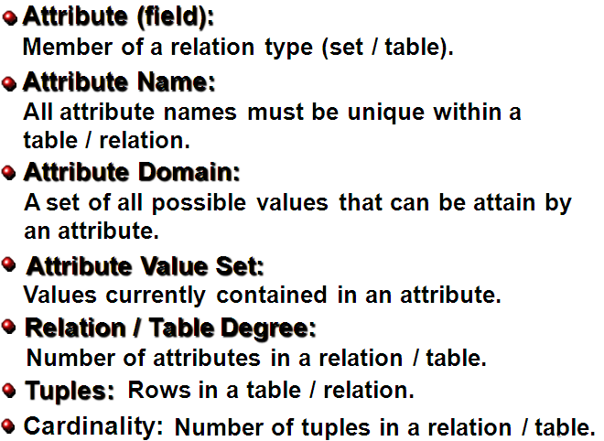
TABLE Structure 2/2

Slide 9
Ex: Instance of Students Relation
Student(studno,name,address)
Course(courseno,lecturer)
Student(123,Bloggs,Woolton)
(321,Jones,Owens)
Schema
Instance
sid | Name | Login | age | GPA
53666 | Jones | Jones@ca | 18 | 3.4
53444 | smith | Smith@ecs | 18 | 3.2
53777 | Blake | Blake@aa | 19 | 3.8
• Cardinality = 3, arity = 5 , all rows distinct
Do all values in each column of a relation instance have to be distinct?

Slide 10
Relational Database Concepts
Table
Field
CD_ID | Title | Artist | Genre
1 | The Wall | Pink Floyd | Rock
2 | Blue Train | John Coltrane | Jazz
3 | Requiem | W.A. Mozart | Classical
Record

Slide 11
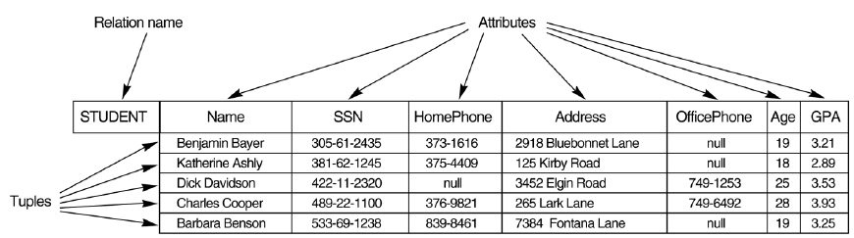
Basic component of a Relation
Tuple:
The actual data values for the attributes of a relation are stored in tuples, or rows, of the table.
It is not necessary for a relation to have rows in order to be a relation; even if no data exists for the relation
The relation remains defined with its set of attributes
Attribute:
The term attribute refers to characteristics. This simply means that what the column contains will be defined by the attribute of the column

Slide 12
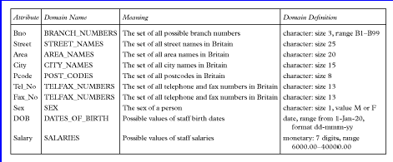
Examples of Attribute Domains

Slide 13
DBMS vs. RDBMS
DBMS | RDBMS
The concepts of relationships is missing in a DBMS. If it exits it is very less. | It is based on the concept Of relationships
Speed of operation is very slow | Speed of operation is very Fast
Hardware and Software requirements are minimum | Hardware and Software requirements are High
Platform used is normally DOS | Platform used can be any DOS, UNIX,VAX,VMS, etc
Uses concept of a file | Uses concept of table
DBMS normally use 3GL | RDBMS normally use a 4GL
Examples are dBase, FOXBASE, etc | Examples are ORACLE, INGRESS, SQL Server 2000 etc

Slide 14
Entity Relationship Modeling Database design
Database design is the process of producing a detailed data model of a database
Process of Database Design:
Determine the relationships between the different data elements.
Superimpose a logical structure upon the data on the basis of these relationships
Database designs also include ER (Entity Relationship Model) diagrams.
An ER diagram is a diagram that helps to design databases in an efficient way.

Slide 15
Entity Relationship Modeling Design Process
Real world
Requirement collection & Analysis
Survey
Interview
Collect requirement
Analisys
Specification
Requirement database
Conceptual design
Modelling
Design
ER Modelling
Conceptual model
……..
Notes:
Determine the purpose of the database - This helps prepare for the remaining steps.
Find and organize the information required - Gather all of the types of information to record in the database, such as product name and order number.
Divide the information into tables - Divide information items into major entities or subjects, such as Products or Orders. Each subject then becomes a table.
Turn information items into columns - Decide what information needs to stored in each table. Each item becomes a field, and is displayed as a column in the table. For example, an Employees table might include fields such as Last Name and Hire Date.
Specify primary keys - Choose each table’s primary key. The primary key is a column that is used to uniquely identify each row. An example might be Product ID or Order ID.
Set up the table relationships - Look at each table and decide how the data in one table is related to the data in other tables. Add fields to tables or create new tables to clarify the relationships, as necessary.
Refine the design - Analyze the design for errors. Create tables and add a few records of sample data. Check if results come from the tables as expected. Make adjustments to the design, as needed.
Apply the normalization rules - Apply the data normalization rules to see if tables are structured correctly. Make adjustments to the tables

Slide 16
Entity Relationship Modeling ER Model Overview
ER Model: High-level data model that is useful in developing a conceptual design for a database
ER Diagram (ERD): One of the first steps in designing a database
ERD Elements:
Entities
Relationships
Attributes
Notes:
In 1976, Chen developed the Entity-Relationship (ER) model, a high-level data model that is useful in developing a conceptual design for a database. Creation of an ER diagram, which is one of the first steps in designing a database, helps the designer(s) to understand and to specify the desired components of the database and the relationships among those components. An ER model is a diagram containing entities or "items", relationships among them, and attributes of the entities and the relationships.

Slide 17
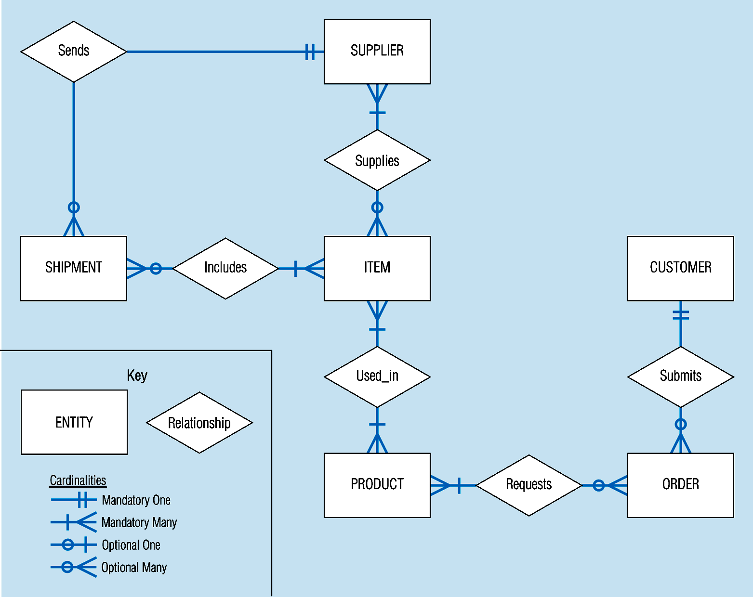
Entity Relationship Modeling
Sample E-R Diagram
Notes:
3

Slide 18
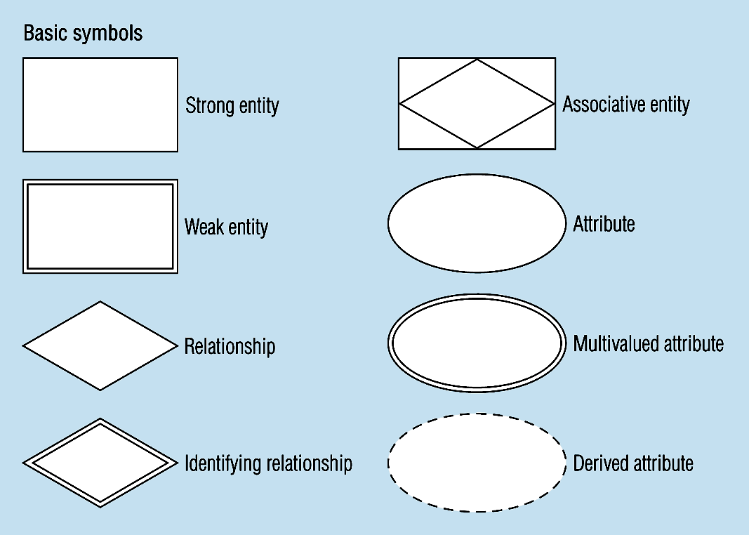
Entity Relationship Modeling
Basic E-R Notation
A special entity that is also a relationship
Entity symbols
Attribute symbols
Relationship symbols
Notes:
8

Slide 19
Entity Relationship Modeling Attributes
Attribute - property or characteristic of an entity type
Classifications of attributes:
Simple versus Composite Attribute
Single-Valued versus Multivalued Attribute
Stored versus Derived Attributes
Identifier Attributes
Notes:
5

Slide 20
Entity Relationship Modeling Identifiers (Keys)
Identifier (Key) - An attribute (or combination of attributes) that uniquely identifies individual instances of an entity type
Simple Key versus Composite Key
Candidate Key – an attribute that could be a key…satisfies the requirements for being a key
Characteristics of Identifiers:
Will not change in value
Will not be null
No intelligent identifiers (e.g. containing locations or people that might change)
Substitute new, simple keys for long, composite keys
Notes:
6

Slide 21
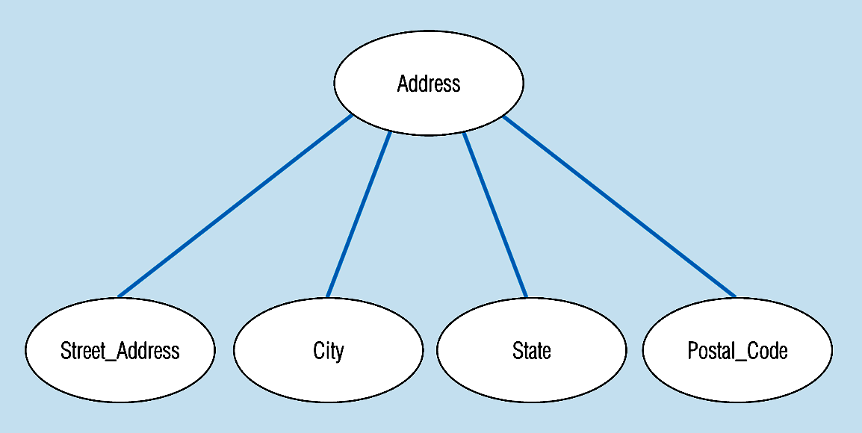
Entity Relationship Modeling
A composite attribute
An attribute broken into component parts
Notes:
12

Slide 22
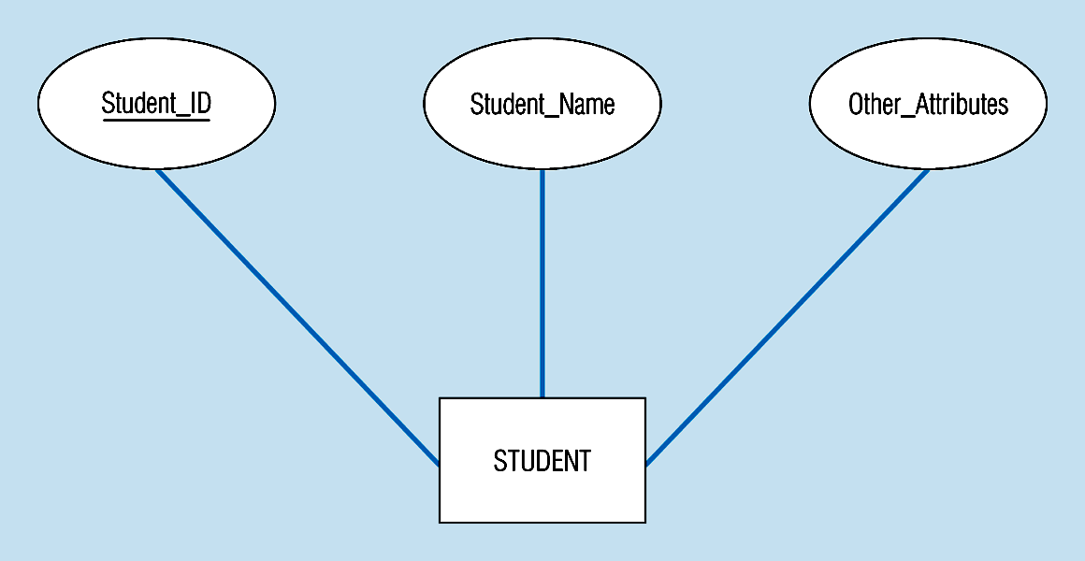
Entity Relationship Modeling
Simple key attribute
The key is underlined
Notes:
14

Slide 23
Entity Relationship Modeling Cardinality of Relationships 1/2
Relationships
One – to – One: Each entity in the relationship will have exactly one related entity
One – to – Many: An entity on one side of the relationship can have many related entities, but an entity on the other side will have a maximum of one related entity
Many – to – Many: Entities on both sides of the relationship can have many related entities on the other side
Cardinality Constraints - the number of instances of one entity that can or must be associated with each instance of another entity.
Minimum Cardinality
If zero, then optional
If one or more, then mandatory
Maximum Cardinality: The maximum number

Slide 24
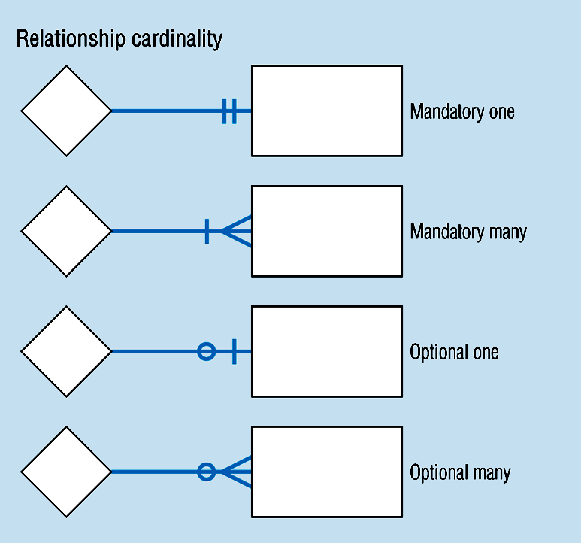
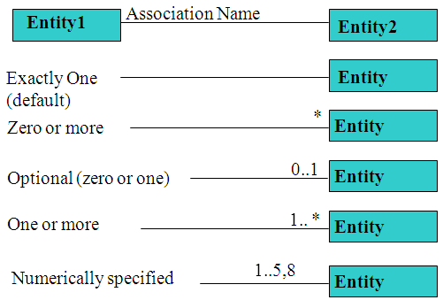
Entity Relationship Modeling
Cardinality of Relationships 2/2
Notes:
8

Slide 25
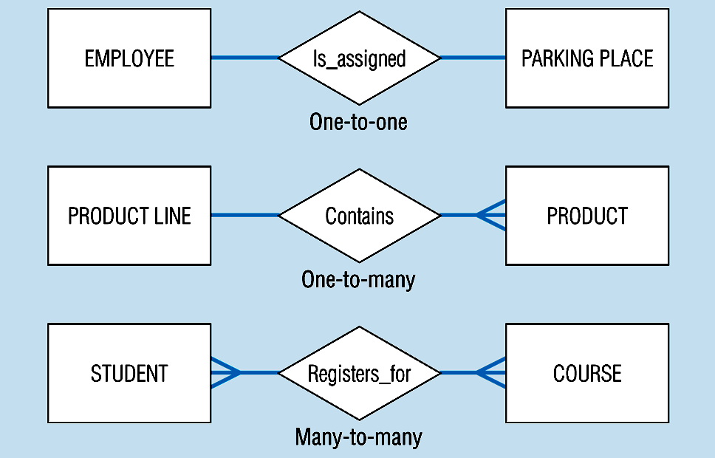
Entity Relationship Modeling
Binary relationships
Notes:
23

Slide 26
ER Model - Convert ER Models to Relational schema (DB Design)
Rules for converting ER Model to relational schema
Basic Conversion Rules
Entity Type Rule
1-M Relationship Rule
M-N Relationship Rule
Identification Dependency Rule
Notes:
Entity Type Rule: Each entity type (except subtypes) becomes a table. The PK of ET (if not weak) becomes the PK of the table. The attributes of the ET become columns in the table. This rule should be used first before the relationship rules.
1-M Relationship Rule: Each 1-M relationship becomes a FK in the table corresponding to the child type (the entity type near Crow’s Foot symbol). If the minimum cardinality on the parent side of the relationship is one, the FK cannot accept null values (NOT NULL must be used).
M-N Relationship Rule: Each M-N relationship becomes a separate table. The PK of the table is a combined key consisting of the primary keys of the entity types participating in the M-N relationship.
Identification Dependency Rule: Each identifying relationship (denoted by a solid relationship line) adds a component to a PK. The PK of the table corresponding to the weak entity consists of:
The underlined local key (if any) in the weak entity and
The PK(s) of the entity type(s) connected by identifying relationship(s).

Slide 27
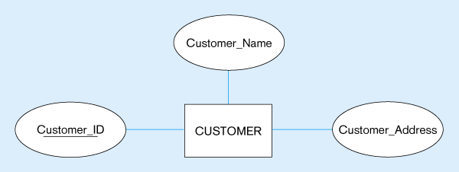
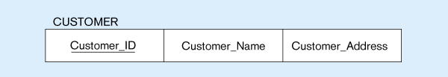
ER Model: DB Design Rule 1 - Example
CUSTOMER entity type with simple attributes
CUSTOMER relation
Biến đổi kiểu thực thể thông thường

Slide 28
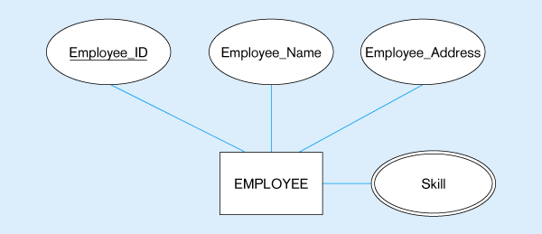
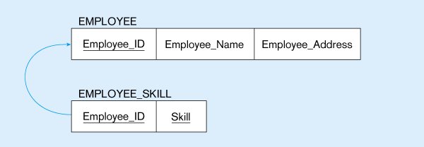
ER Model: DB Design Rule 2 - Example
Multivalued attribute becomes a separate relation with foreign key
1–to–many relationship between original entity and new relation
Convert Multivalue attribute

Slide 29
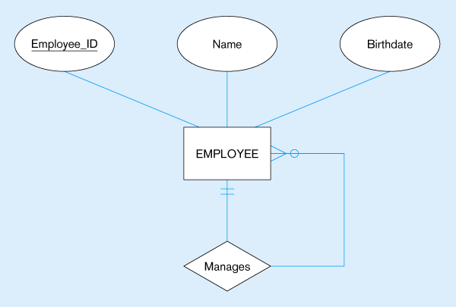
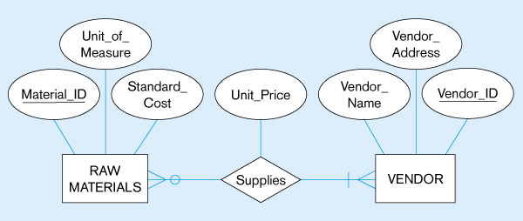

ER Model: DB Design Rule 3 - Example
EMPLOYEE entity with Manages relationship
EMPLOYEE relation with recursive foreign key
Convert Unary relationship one to one

Slide 30
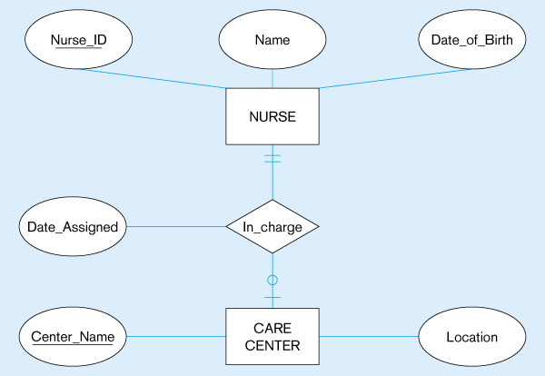
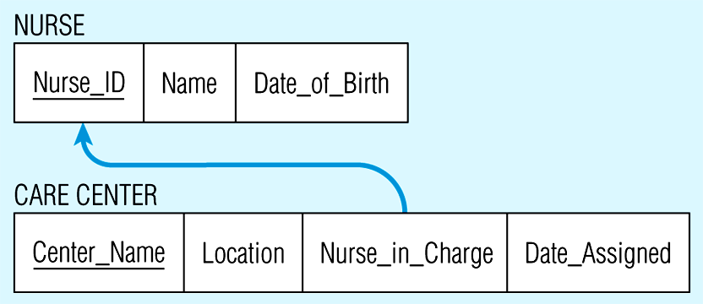
ER Model: DB Design Rule 3 - Example
Convert binary relationship one to one

Slide 31
ER Model: DB Design Rule 3 - Example
EMPLOYEE entity with Manages relationship
EMPLOYEE relation with recursive foreign key
Convert Unary relationship one to many

Slide 32
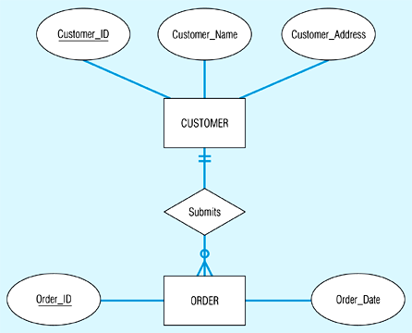
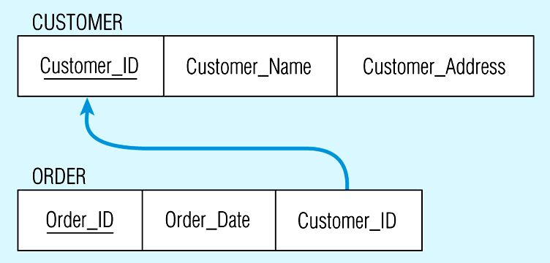
ER Model: DB Design Rule 3 - Example
Note the mandatory one
Again, no null value in the foreign key…this is because of the mandatory minimum cardinality
Convert Binary relationship one to many

Slide 33
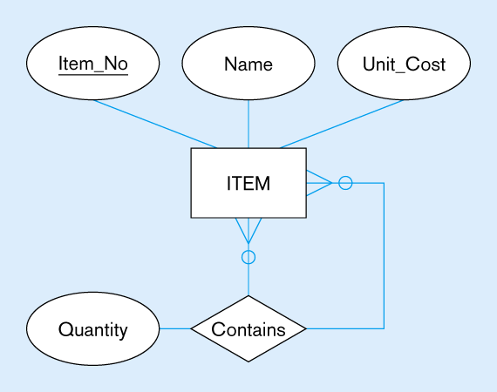
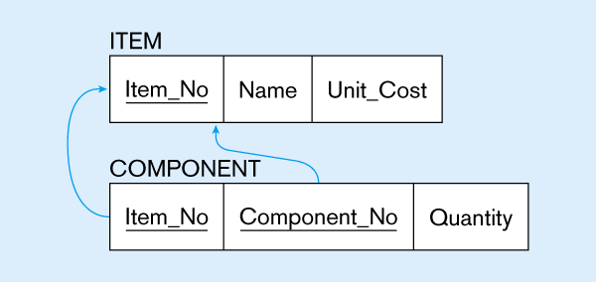
ER Model: DB Design Rule 3 - Example
Bill-of-materials relationships (M:N)
ITEM and COMPONENT relations
Convert Unary relationship many to many

Slide 34
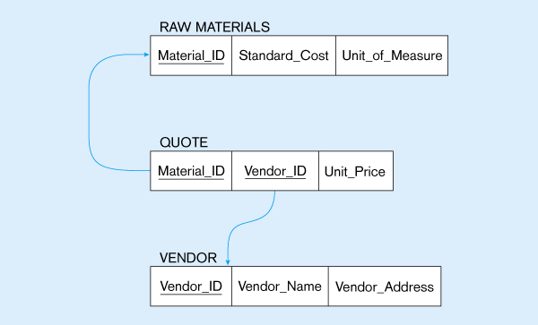
ER Model: DB Design Rule 3 - Example
The Supplies relationship will need to become a separate relation
Composite primary key
New intersection relation
Foreign key
Foreign key
Convert Binary relationship many to many

Slide 35
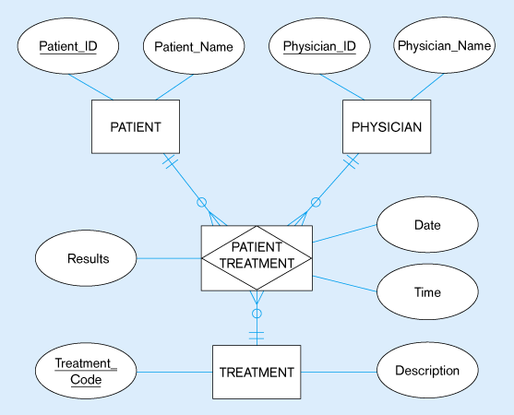
ER Model: DB Design Another Converting Example
Convert Ternary relationship

Slide 36
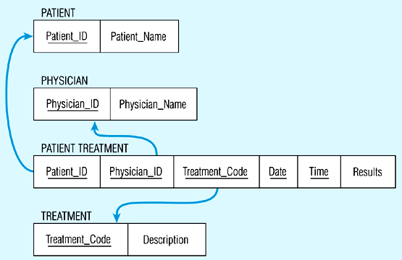
ER Model: DB Design Another Converting Example
Convert Ternary relationship

Slide 37
Ms SQL Server Overview
What is SQL?
Ms SQL Server Overview
Ms SQL Server Components

Slide 38
What is SQL?
SQL stands for Structured Query Language
SQL allows access and manipulate databases
SQL is an ANSI (American National Standards Institute) standard
What Can SQL do?
Retrieve, insert, update, and delete database records
Create new or update database structures: table, view, stored procedures, etc.
Grant access permission to database objects: tables, stored procedures, views.

Slide 39
Ms SQL Server Overview
Microsoft SQL Server is a database platform for:
Online Transaction Processing (OLTP)
Data warehousing, e-commerce applications
It is also a business intelligence platform for:
Data integration, analysis, and reporting solutions.

Slide 40
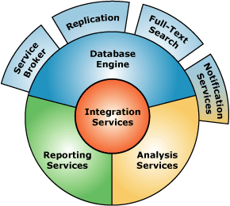
Ms SQL Server Components

Slide 41
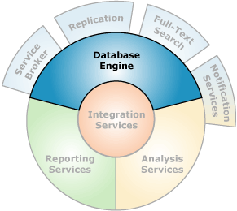
Database Engine
Database Engine is the core service for storing, processing, and securing data
This includes creating tables for storing data, and database objects such as indexes, views, and stored procedures for viewing, managing, and securing data

Slide 42
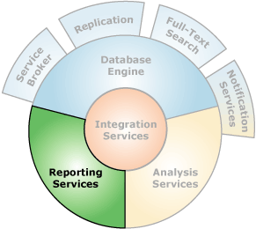
Reporting Service
Reporting Services (SSRS) includes:
A complete set of tools that you can use to create and manage reports,
An application programming interface (API) that allows developers to integrate or extend data and report processing in custom applications

Slide 43
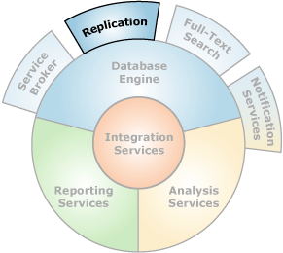
Replication
Replication is a set of technologies for copying and distributing data and database objects from one database to another, and then synchronizing between databases to maintain consistency

Slide 44
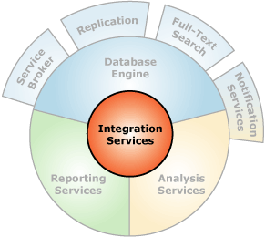
Integration Services
Integration Services (SSIS) is a platform for building high performance data integration solutions, including extraction, transformation, and load packages for data warehousing

Slide 45
Ms SQL Server Tools
SQL Server Management Studio
SQL Profiler

Slide 46
SQL Server Management Studio
SQL Server Management Studio (SSMS) is used for configuring, managing, and administering all components within Microsoft SQL Server
This includes both script editors and graphical tools which work with objects and features of the server

Slide 47
SSMS Demo
Demo
Notes:
See SSMS_Demo.docx

Slide 48
SQL Profiler
SQL Server Profiler is a tool that allows capture and analyze events, such as the execution of a stored procedure, occurring within SQL Server. This information can be used to identify and troubleshoot many SQL Server-related problems

Slide 49
SQL Profiler Demo
Demo
Notes:
See SQLServerProfiler_Demo.docx

Slide 50
Ms SQL Server Data Types
SQL Server supports below data types. NULL is default value for most data type:
Exact Numerics
Approximate Numerics
Date and Time
Character Strings
Unicode Character Strings
Binary Strings
Other Data Types

Slide 51
Exact Numbers
Bigint: 8 Bytes.
Store integer data from -2^63 to 2^63-1
This is used in special case where the integer values exceed the range supported by the int data type.
Int: 4 Bytes.
Store integer data from -2^31 to 2^31 - 1
This can be used to store primary key of a table.
Smallint. 2 Bytes.
Store integer data from -2^15 to 2^15 - 1
Tinyint: 1 Byte.
Store integer data from 0 through 255
This can be used to store primary key of table as Gender or Title
Decimal: Numeric data types that have fixed precision and scale
Numeric: The same as Decimal
Bit: This can take a value of 1, 0, or NULL.
Money: 8 Bytes. This should be used in special case, in normal case we should use decimal instead

Slide 52
Exact Numbers Demo
Demo
Notes:
Use Exact_DataType.sql file

Slide 53
Approximate Numerics
Float
Real

Slide 54
Approximate Numerics Demo
Demo
Notes:
Use Approxiate_DataType.sql file

Slide 55
Date and Time
SQL support below Date and Time data type:
Date
Datetimeoffset
Datetime2
Smalldatetime
Datetime
Time

Slide 56
Date and Time demo
Demo
Notes:
See Date_and_Time.sql

Slide 57
Character Strings
Char(n): Fixed length, non-Unicode string data. 1<=n<=8000
Varchar(n|max): Stores non-Unicode string data
n defines the string length and can be a value from 1 through 8,000
max indicates that the maximum storage size 2GB
Nchar(n): Fixed length, Unicode string data
Nvarchar(n|max): Stores Unicode string data

Slide 58
Binary Strings
Binary
Varbinary
Image

Slide 59
Binary Strings Demo
Demo
Notes:
Use Binary_DataType.sql

Slide 60
Other Data Types
timestamp
hierarchyid
uniqueidentifier
sql_variant
xml
table

Slide 61
Other Data Types Demo
Demo
Notes:
Use Other_DataType.sql

Slide 62


